Slide 1
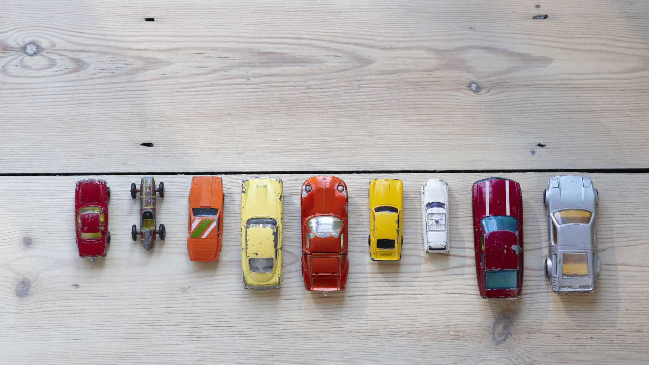
Car Price Analysis using predictive modelling
L.G.

Slide 2

Pipeline

Slide 4
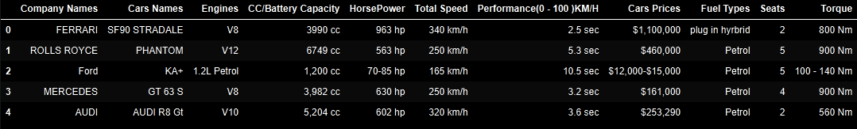
Data
Kaggle Dataset:
1,218 Entries
11 Features

Slide 6
Data
Kaggle Dataset:
1,218 Entries
11 Features

Slide 7
Cleaning Data
Duplicates
Missing Values
Fill with mean for numeric values and mode for categorical (where applicable)
Impossible values
E.g. Negative prices
Typos
AllCaps Company names
“plug in hyrbrid” -> “Hybrid”

Slide 8
Cleaning Data
Remove non-useful cell information
“cc”, “hp”, “Nm”
Correct types
“Hybrid (Gas + Electric) -> Hybrid
Using EDA to identify and correct/remove outliers

Slide 9
Before and after Cleaning Data

Slide 11
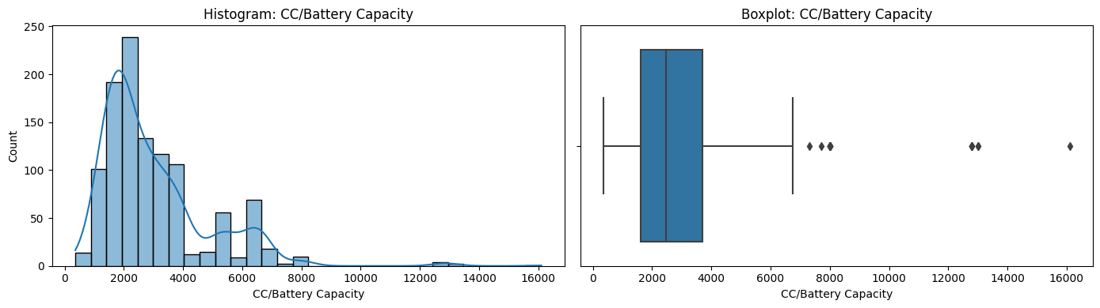
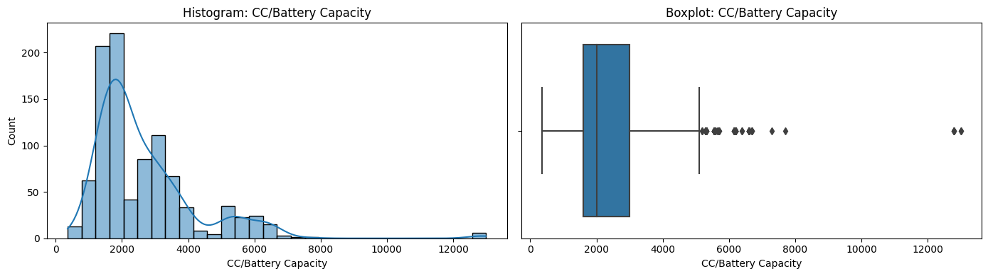
Before and after removing outliers

Slide 12
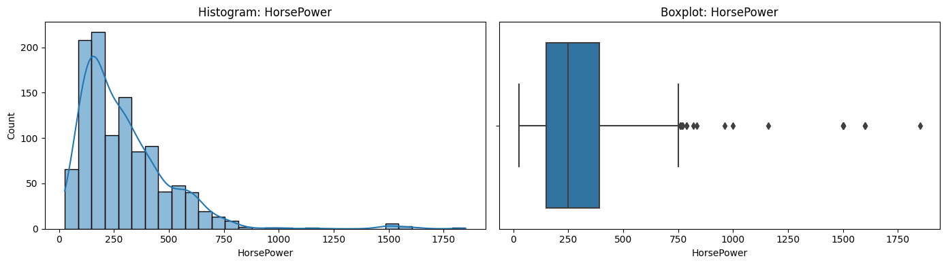
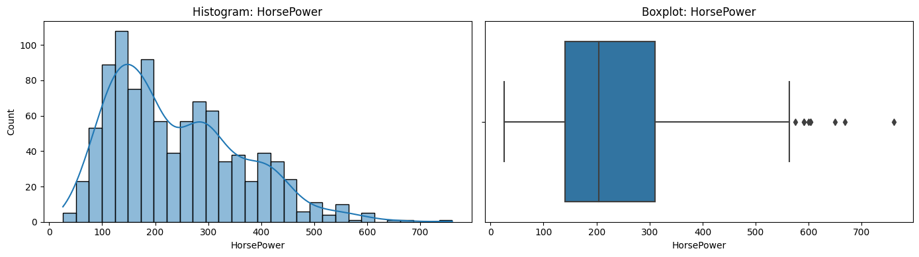
Before and after removing outliers

Slide 13
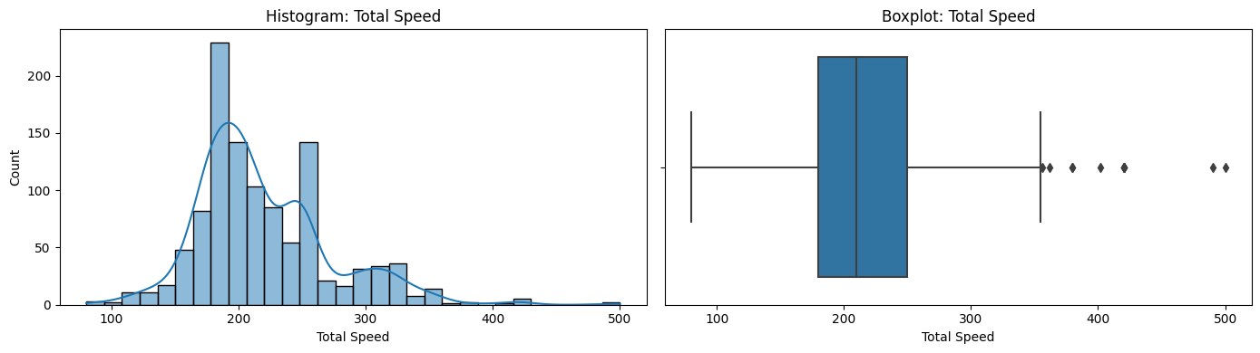
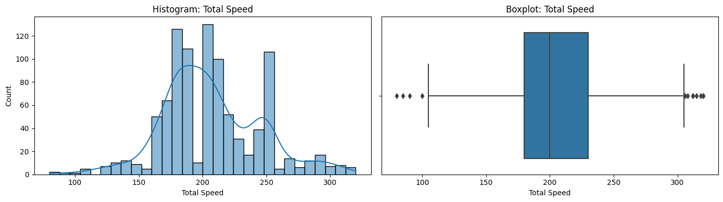
Before and after removing outliers

Slide 14
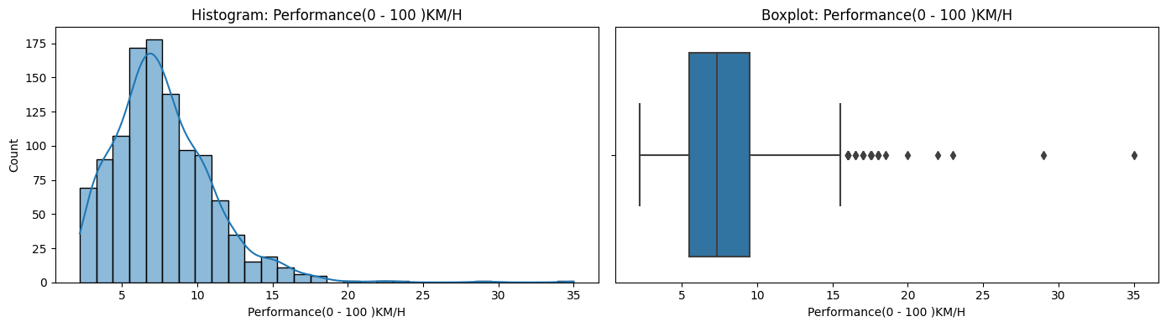
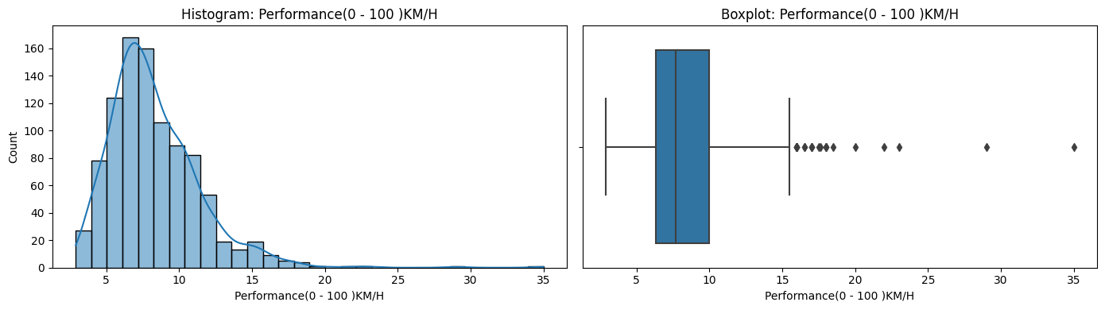
Before and after removing outliers

Slide 15
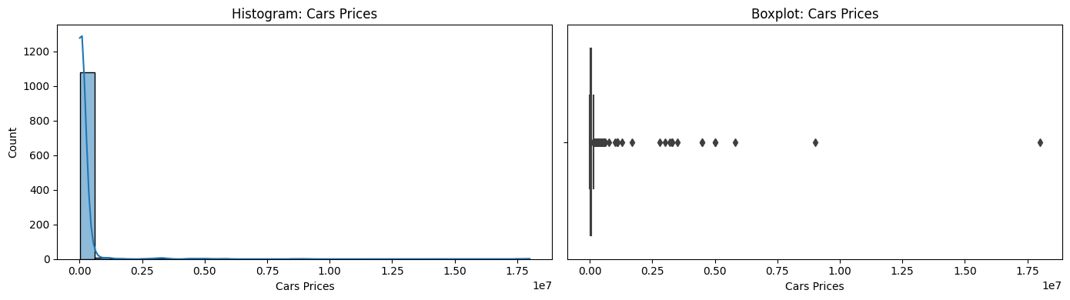
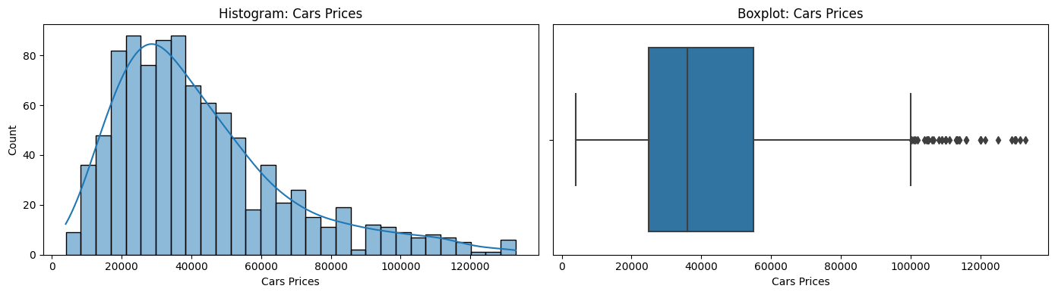
Before and after removing outliers

Slide 16
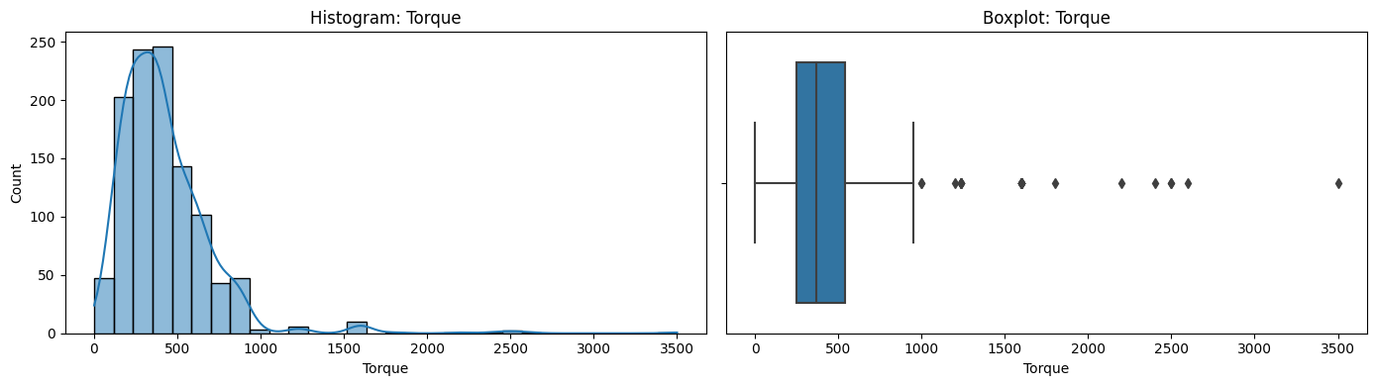
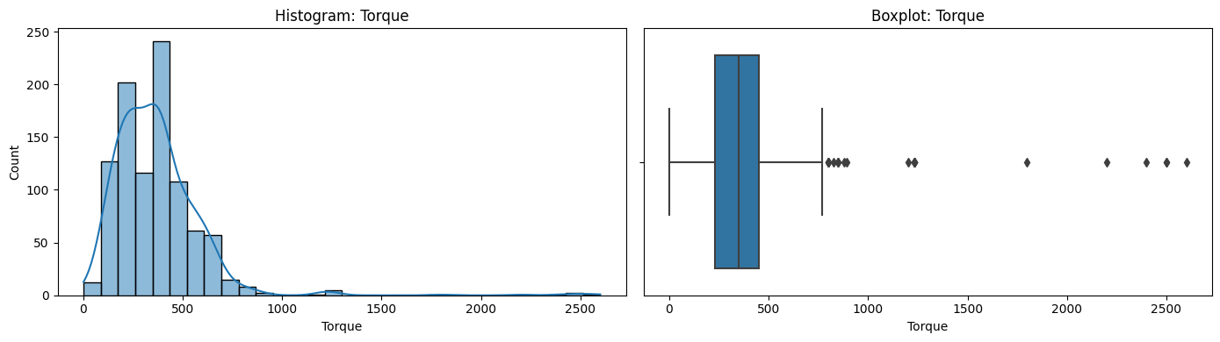
Before and after removing outliers

Slide 17
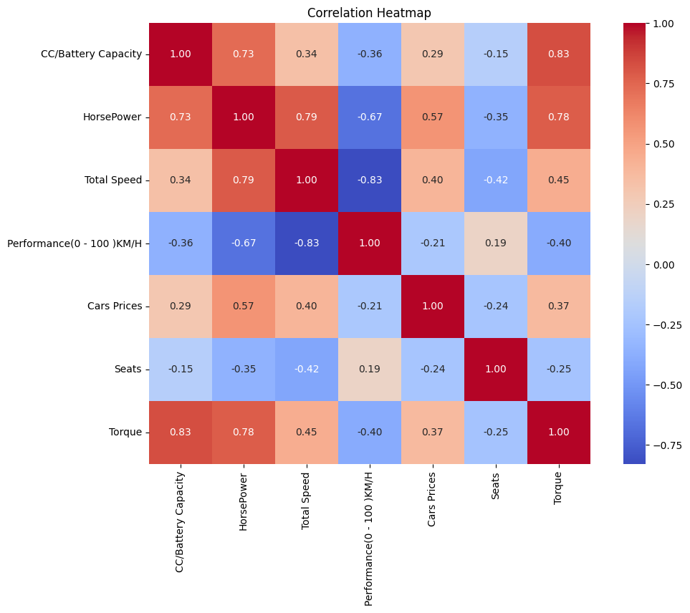
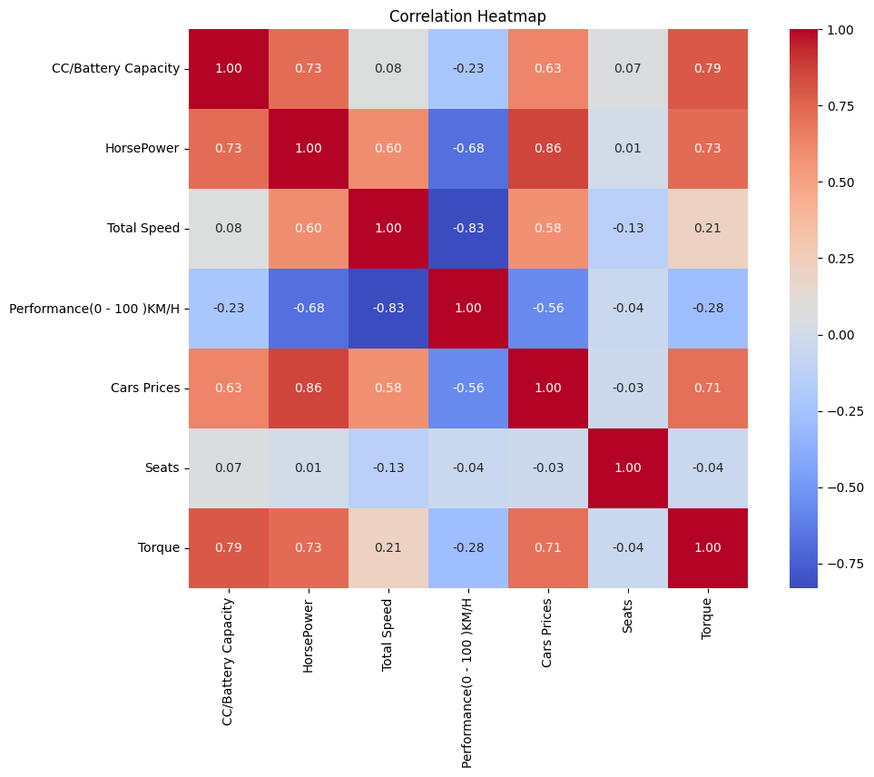
Before and after removing outliers

Slide 18
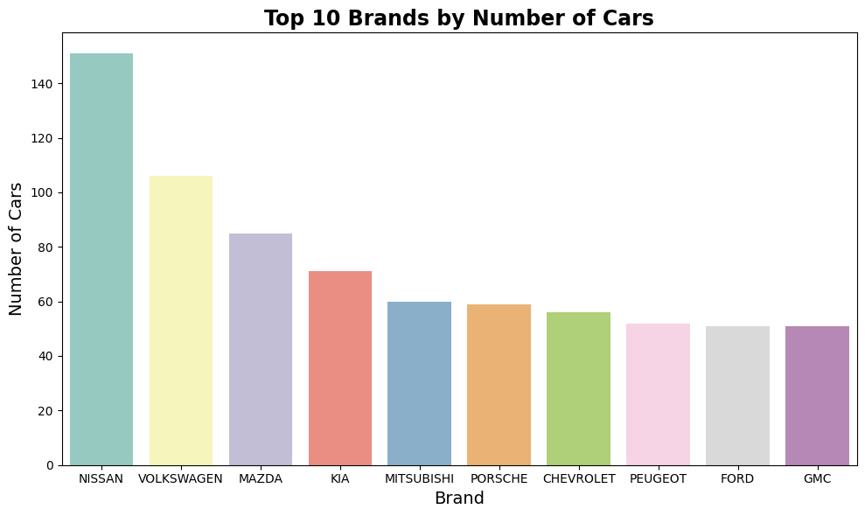

Slide 19
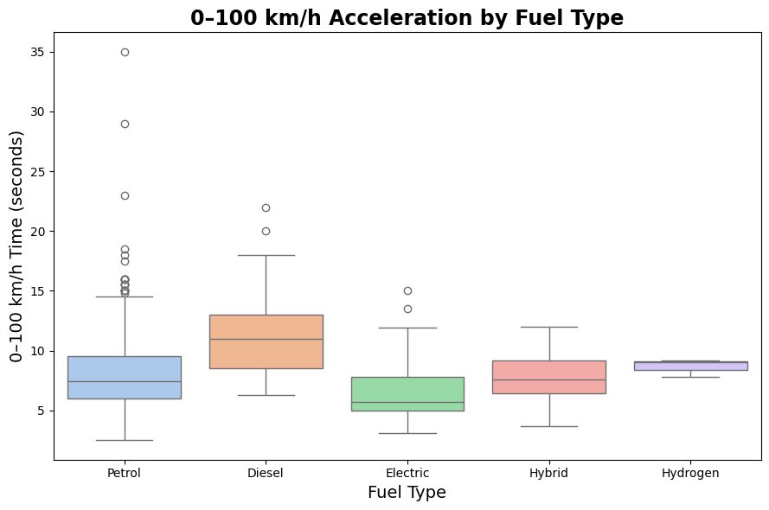

Slide 20
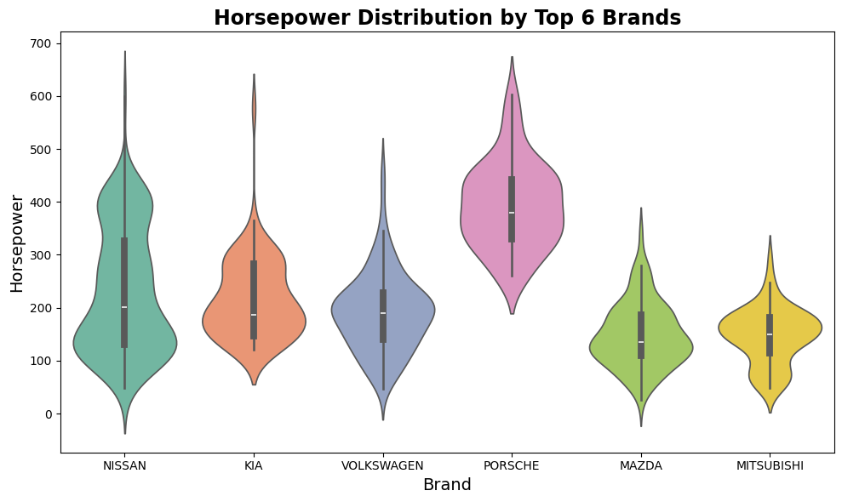

Slide 21
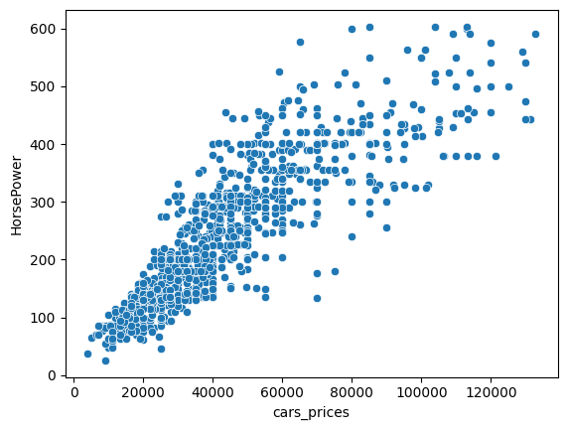

Slide 22
Feature Engineering
HorsePower per CC/Battery Capacity
Price per HorsePower
Price per Seat
HorsePower/Acceleration effectiveness
Price tierlists (Budget, Mid-tiered, Luxury, Supercar)
Cylinders

Slide 23
Models
Linear Regression
DecisionTree

Slide 24
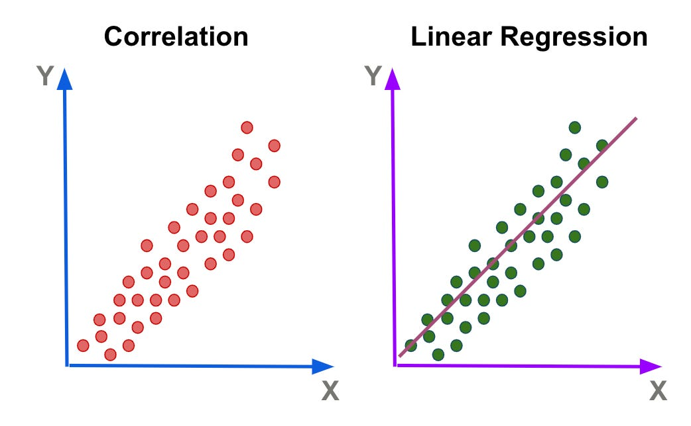
Linear Regression
Finds best-fitting line by minimizing prediction errors
Calculates coefficients for variables that minimize errors

Slide 25
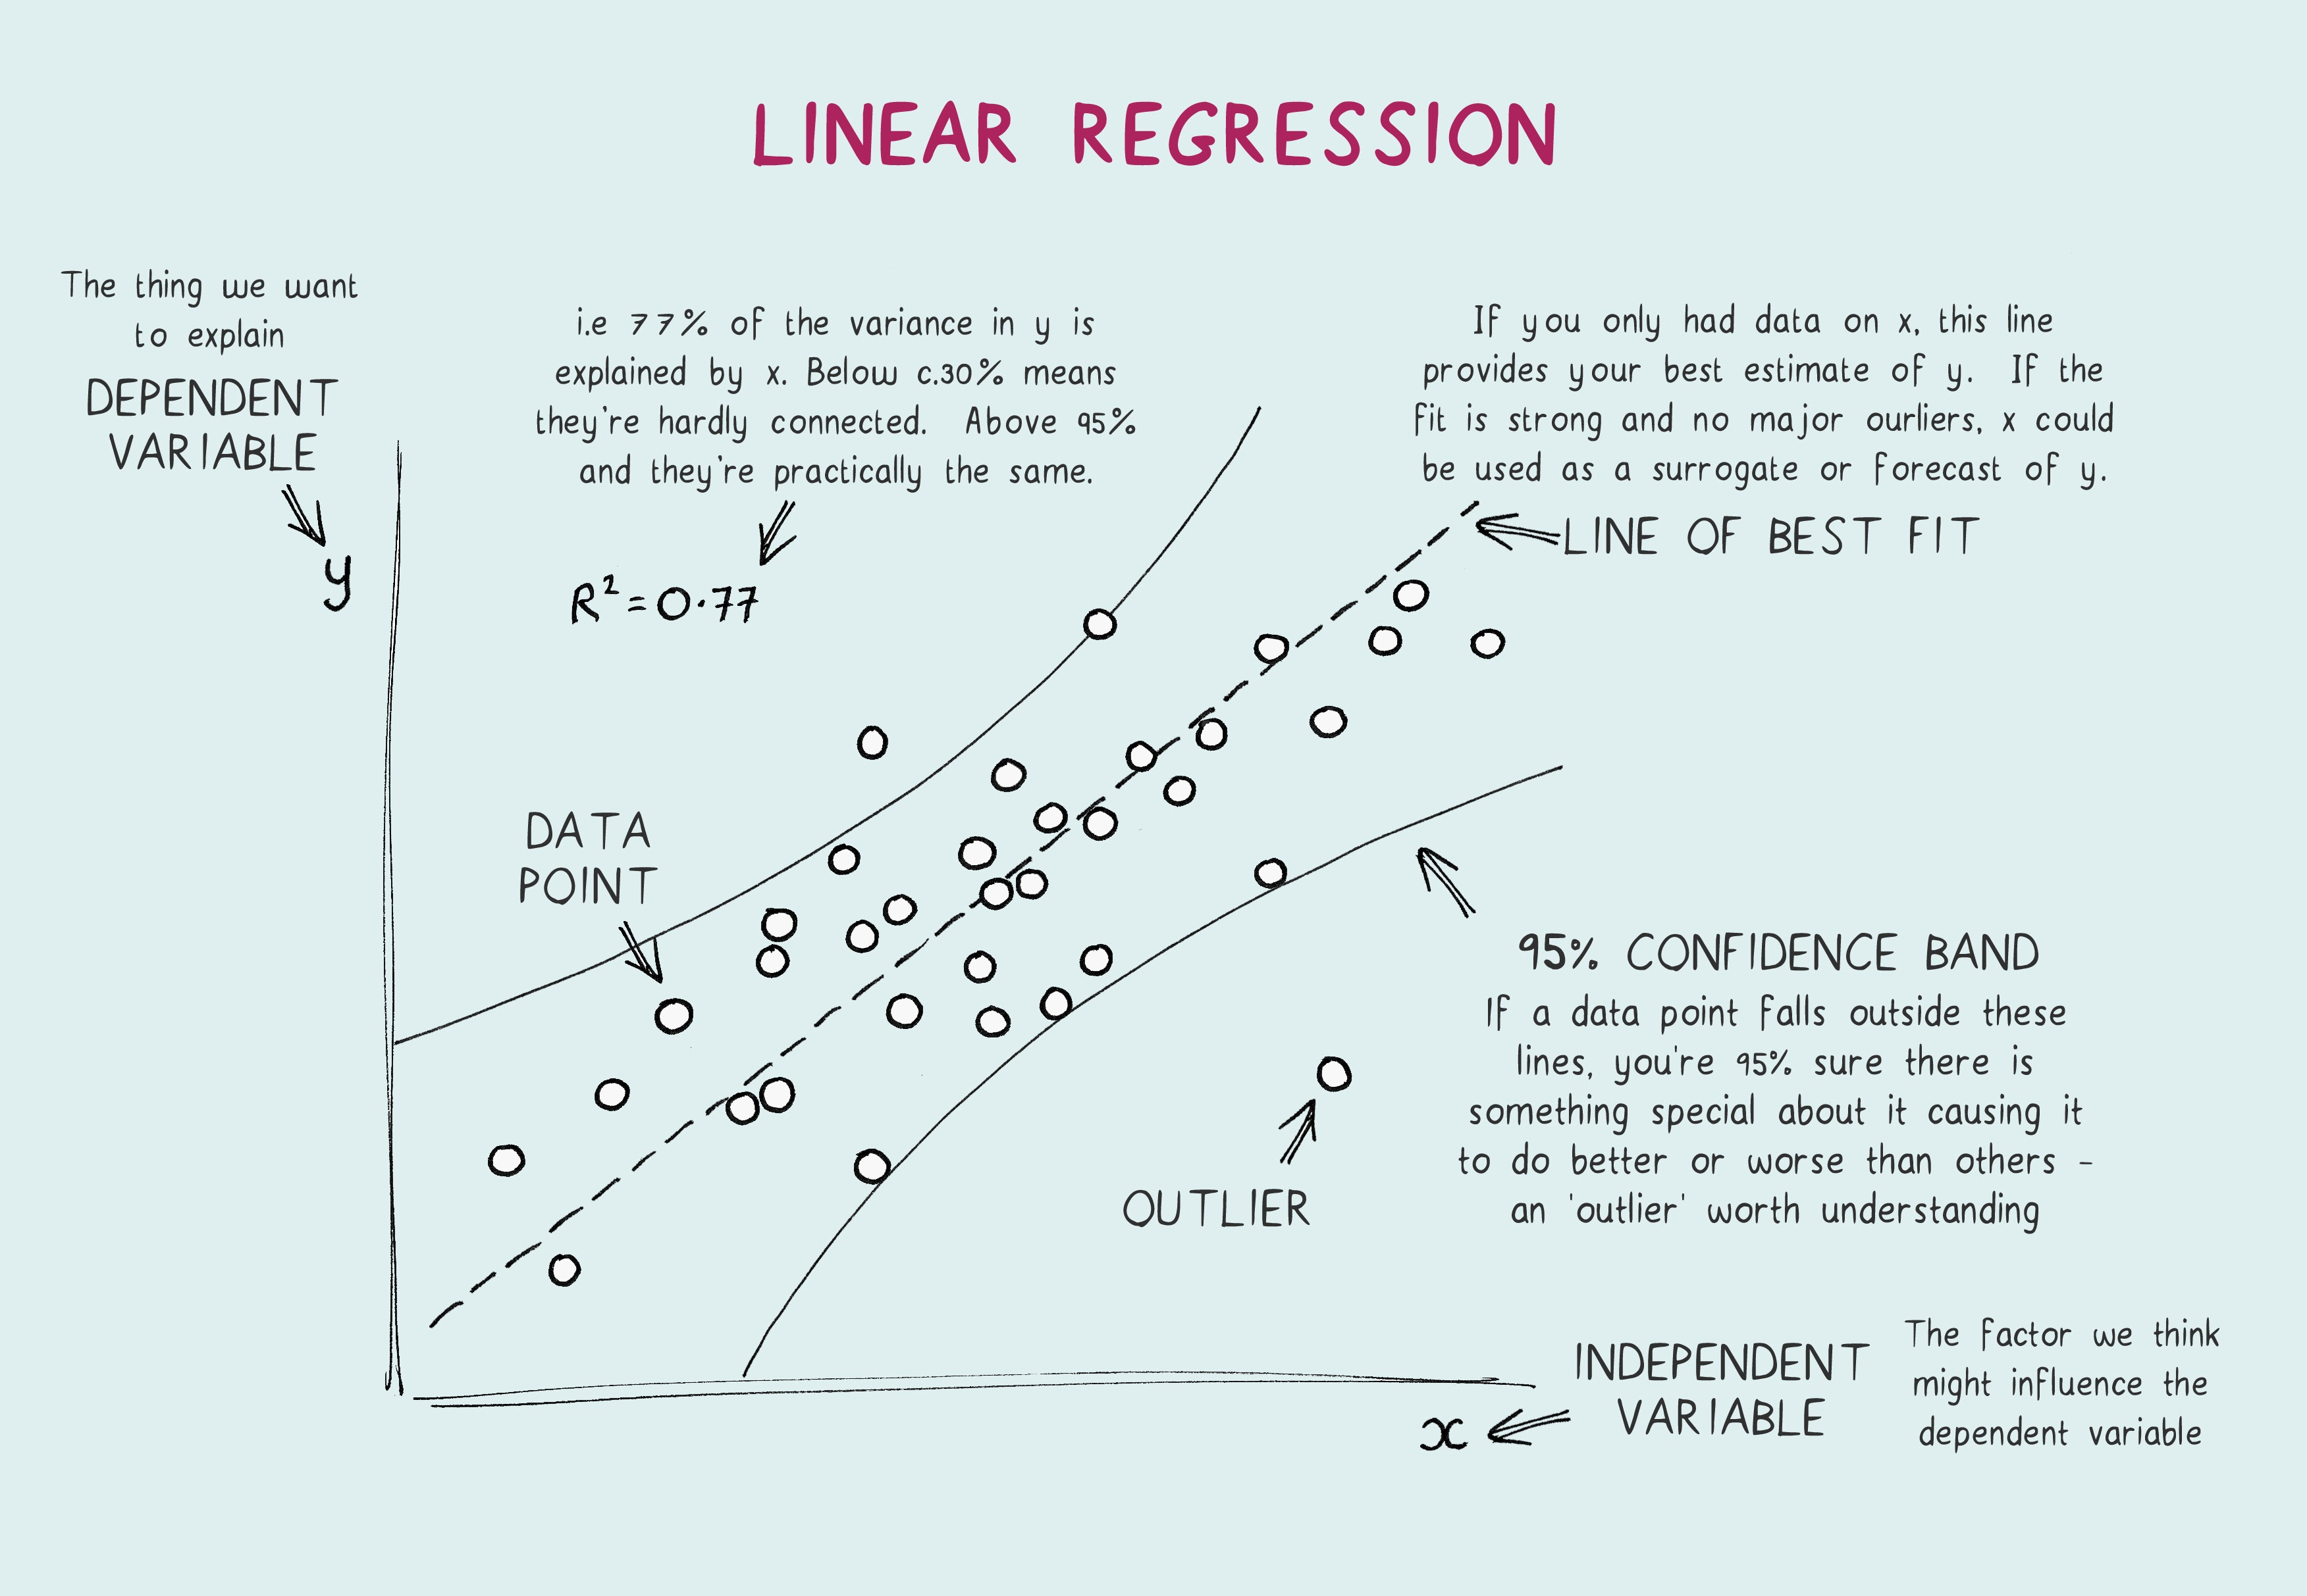
Linear Regression
Assumes there’s a straightline relationship (E.g. between HorsePower and Car_Price)

Slide 26
Linear Regression
Strengths:
Fast
Easy interpretation
Weaknesses:
Struggles when the relationship is not linear but, for example, exponential
Very sensitive to outliers

Slide 27
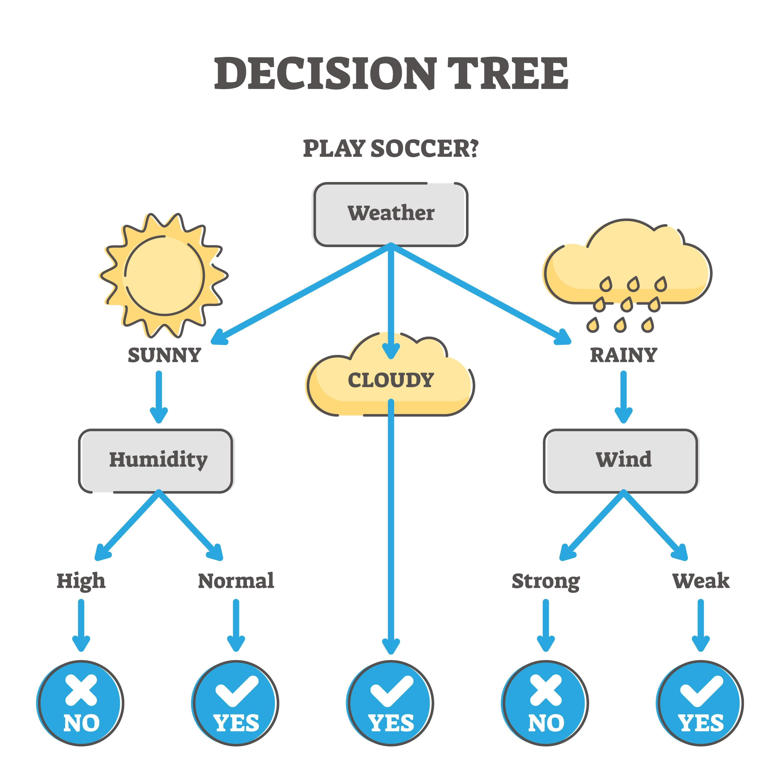
Decision Tree
Flowchart
"Is HorsePower > 200?" -> "Yes" -> "Is Fuel Type = Electric?" -> "Yes" -> Price = $55,000.

Slide 28
Decision Tree
Strengths:
Can handle exponential relationships, unlike linear regression
Less sensitive to outliers, the entire model does not get ruined by a few
Weaknesses:
Prone to overfitting
Bias towards features with more categories

Slide 29

Evaluation
Mean Absolute Error (MAE): Average amount the model is off by
1
Root Mean Square Error (RMSE): Penalises bigger errors more heavily, squaring ensures positive and negative results are treated equally
2
R-squared (R2): Proportion of price variation -> main accuracy
3

Slide 30
Evaluation
Metric | Linear Regression | Decision Tree
MAE (Mean Absolute Error) | $8,930 | $7,647
RMSE (Root Mean Square Error) | $12,533 | $11,671
R² Score (Accuracy) | 77.8% | 80.7%

Slide 31
Pycaret
Open source machine learning library
Automates machine learning workflow from variety of machine learning libraries (XGBoost, K Neighbors, Random Forest, etc)

Slide 32
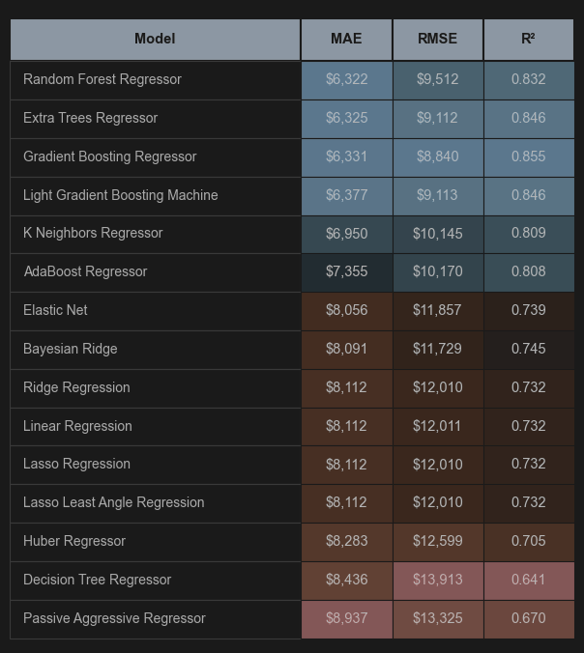
Pycaret – Model Comparison

Slide 33
Pycaret SHAP & LIME
Feature | SHAP (Summary) | LIME (Individual)
Usage | Understand the market (What makes a car expensive in general?) | Understand one car (Why is this specific Ford KA+ so cheap?)
Insights | Shows that HorsePower and Fuel Type are the main drivers. | Shows that for this car the low HorsePower was the main reason for the low price.
Reliability | Extremely reliable | Varies but is much easier for a non-technical person to read.

Slide 34
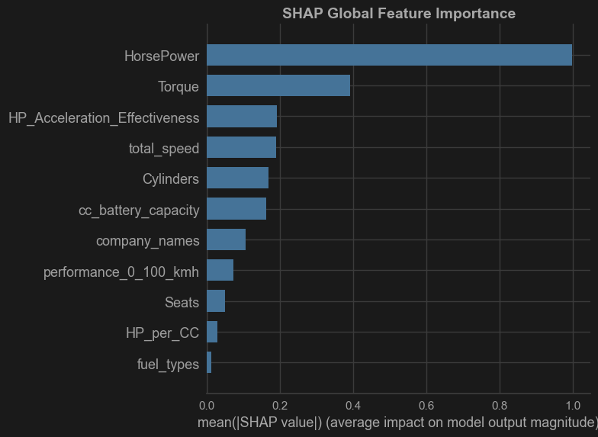
Pycaret - SHAP

Slide 35
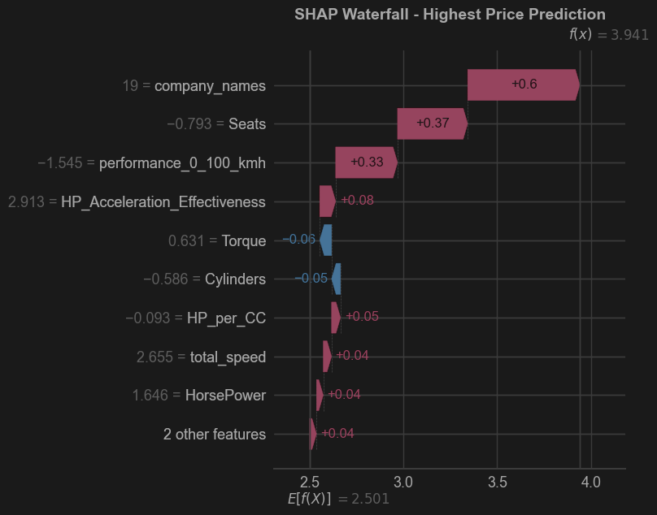
Pycaret - SHAP

Slide 36
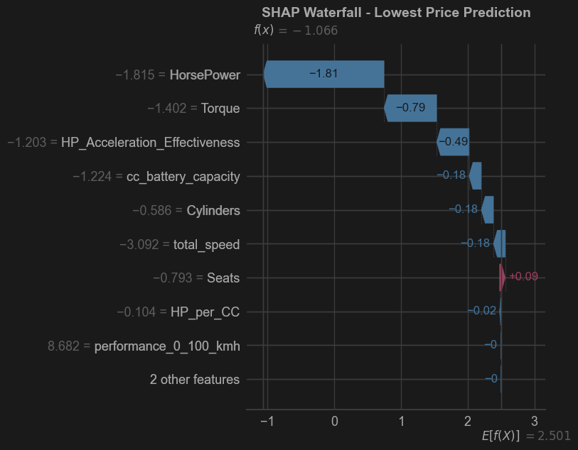
Pycaret - SHAP

Slide 37
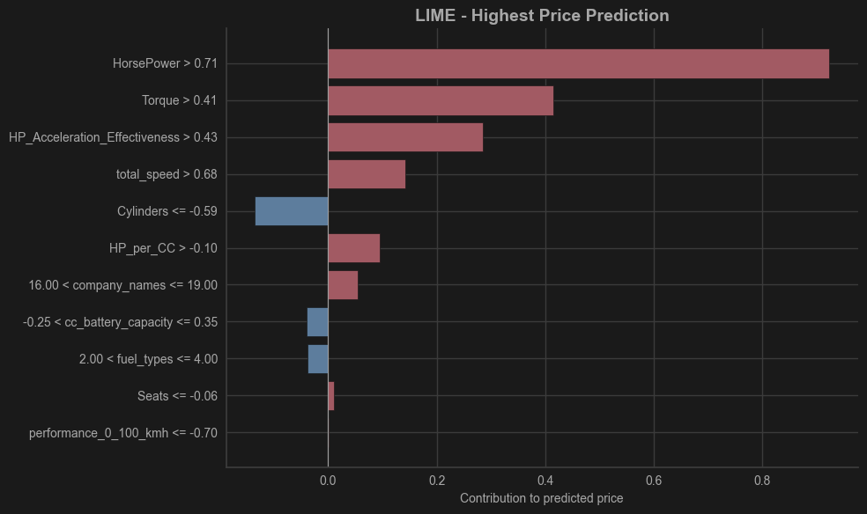
Pycaret - LIME

Slide 38
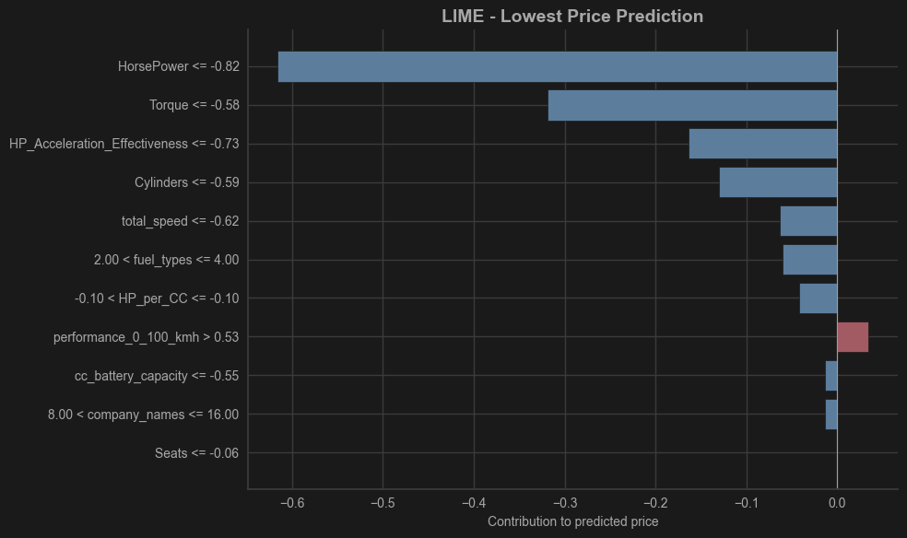
Pycaret - LIME

Slide 39
Interesting things to consider
Electric vehicles have the highest average price
Electric cars lack a budget option. First manufacturers to successfully offer a budget option with capture an enormous market share.

Slide 40
Interesting insights to consider
When looking at Price per horsepower Petrol is the cheapest (~$175 per HP)
Electric is surprisingly competitive (~$198 per HP), cheaper than Diesel (~$214 per HP)
Diesel cars will likely become less of the marketshare before fully fading out, being replaced by electric

Slide 41
Interesting insights to consider
Recommended to be cautious of brands tied heavily to diesel types
Market seems to be moving to Hybrid and Electric for both performance and luxury

Slide 42
Interesting insights to consider
Hydrogen is by far the most expensive (~$302 per HP), as it is new technology
Future sales predicted to be low
Unlikely to become large marketshare unless a new technological outbreak occurs

Slide 43
Interesting insights to consider
Looking at HP_per_CC we see that Petrol and Diesel are not very efficient
Electric and Hybrid’s efficiency ratios are much higher
Possible that efficiency will play a much larger role in the future in the metric of car price or luxury status. (Currently this is still 0-100 speed)

Slide 44
Interesting insights to consider
Horsepower is the most important thing to consider when it comes to predicting prices of a car
The number of seats have little to no impact to the overall car prices. The future of car pricing will not depend on the interior of a car (seats wise) as much as the performance does.

Slide 45
Interesting things to consider
Porsche and Volvo lead in Luxury/Performance spaces (average prices over $90,000)
Nissan and Ford represent the largest volume for the more affordable vehicle group

